Slide 1
CT4029 Principles of Programming Day 3 – Session 6 Basics of data structures

Slide 2
Learning Outcomes
Managing Data Efficiently
Strings Operations
Lists Operations
Tuples Operations
Dictionaries Operations
Arrays Operations

Slide 3
Today’s Agenda!
Basics of Data Structures
Strings
Lists
Mutables
Tuples
Dictionaries
Arrays

Slide 4
Basics of data structures

Slide 5
Data Structures and Algorithms
Part of the “Science” in computer science is the design and use of data structures and algorithms
As you go on in programming, you will learn more and more about these two areas

Slide 6
Data Structures
Data structures are particular ways of storing data to make some operation easier or more efficient. That is, they are tuned for certain tasks
Data structures are suited to solving certain problems, and they are often associated with algorithms.

Slide 7
Kinds of data structures
Roughly two kinds of data structures:
built-in data structures, data structures that are mainly provided by default by programming language
user-defined data structures (classes in object oriented programming) that are designed for a particular task

Slide 8
Python Built in Data Structures
Python comes with a general set of built in data structures:
Strings
Lists
Tuples
Dictionaries
Arrays
others...

Slide 9
Strings

Slide 10
Strings (str)
Strings in Python are identified as a contiguous set of characters represented in the quotation marks. Python allows for either pairs of single or double quotes. Subsets of strings can be taken using the slice operator ([ ] and [:] ) with indexes starting at 0 in the beginning of the string and working their way from -1 at the end.
The plus (+) sign is the string concatenation operator and the asterisk (*) is the repetition operator.

Slide 11
Strings (str)
For example:
This will produce the following result:
str = 'Hello World!’
print str # Prints complete string
print str[0] # Prints first character of the string
print str[2:5] # Prints characters starting from 3rd to 5th
print str[2:] # Prints string starting from 3rd character
print str * 2 # Prints string two times
print str + "TEST“ # Prints concatenated string
Hello World!
H
llo
llo World!
Hello World!Hello World!
Hello World!TEST

Slide 12
Strings (str)
We can write a string of characters in different ways:
in quotation marks ( " This is a string of characters " );
between single quotes ( ' This is a string of characters ' );
between triple quotation marks ( """ This is a string of characters """ ).

Slide 13
Lists

Slide 14
Lists
Lists are the most versatile of Python's compound data types. A list contains items separated by commas and enclosed within square brackets ([]). To some extent, lists are similar to arrays in C. One difference between them is that all the items belonging to a list can be of different data type.
The values stored in a list can be accessed using the slice operator ([ ] and [:]) with indexes starting at 0 in the beginning of the list and working their way to end -1. The plus (+) sign is the list concatenation operator, and the asterisk (*) is the repetition operator.

Slide 15
The Python List Data Structure
A list is an ordered sequence of items.
You have seen such a sequence before in a string. A string is just a particular kind of list (what kind)?

Slide 16
Make a List
Like all data structures, lists have a constructor, named the same as the data structure. It takes an iterable data structure and adds each item to the list
It also has a shortcut, the use of square brackets [ ] to indicate explicit items.

Slide 17
Lists
list = [ 'abcd', 786 , 2.23, 'john', 70.2 ]
tinylist = [123, 'john’]
print list # Prints complete list
print list[0] # Prints first element of the list
print list[1:3] # Prints elements starting from 2nd till 3rd
print list[2:] # Prints elements starting from 3rd element
print tinylist * 2 # Prints list two times
print list + tinylist # Prints concatenated lists
For example:
This produce the following result:
['abcd', 786, 2.23, 'john', 70.2]
abcd
[786, 2.23]
[2.23, 'john', 70.2]
[123, 'john', 123, 'john’]
['abcd', 786, 2.23, 'john', 70.2, 123, 'john']

Slide 18
Make a list

Slide 19
Similarities with strings
Concatenate + (but only of lists)
Repeat *
Indexing (the [ ] operator)
Slicing ([:])
Membership (the in operator)
Len (the length operator)

Slide 20
Operators
[1, 2, 3] + [4] ⇒ [1, 2, 3, 4]
[1, 2, 3] * 2 ⇒ [1, 2, 3, 1, 2, 3]
1 in [1, 2, 3] ⇒ True
[1, 2, 3] < [1, 2, 4] ⇒ True
Compare index to index, first difference determines the result

Slide 21
Differences between lists and strings
Lists can contain a mixture of any python object, strings can only hold characters
1,"bill",1.2345, True
Lists are mutable, their values can be changed, while strings are immutable
Lists are designated with [ ], with elements separated by commas, strings use " " or ' '

Slide 22
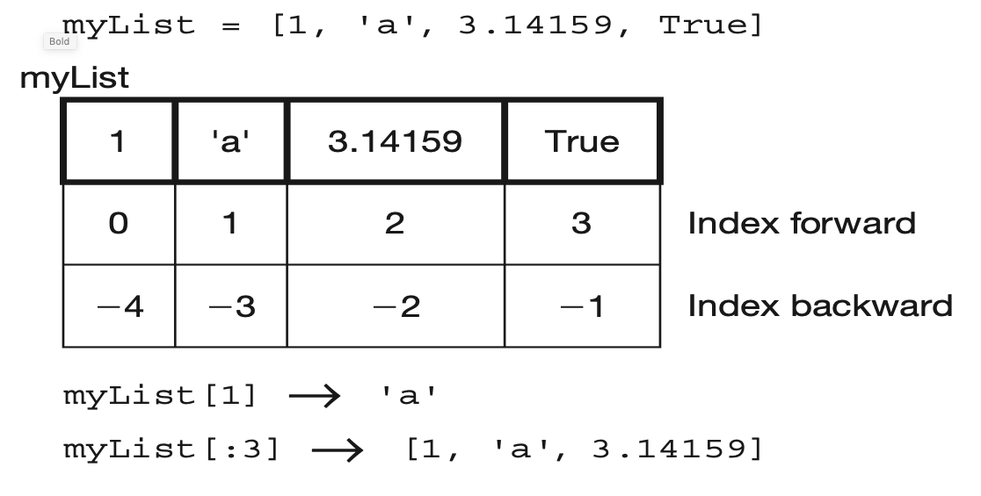

Slide 23
List of Lists
my_list = ['a', [1, 2, 3], 'z']
What is the second element (index 1) of that list? Another list.
my_list[1][0] # apply left to right
my_list[1] ⇒ [1, 2, 3]
[1, 2, 3][0] ⇒ 1
What will be the output of my_list [1][0]

Slide 24
List Functions
len(lst): number of elements in list (top level). len([1, [1, 2], 3]) ⇒ 3
min(lst): smallest element. Must all be the same type!
max(lst): largest element, again all must be the same type
sum(lst): sum of the elements, numeric only

Slide 25
Iteration
You can iterate through the elements of a list like you did with a string:

Slide 26
Mutables

Slide 27
Change an object's contents
Strings are immutable. Once created, the object's contents cannot be changed. New objects can be created to reflect a change, but the object itself cannot be changed
my_str = 'abc'
my_str[0] = 'z' # cannot do!
# instead, make new str
new_str = my_str.replace('a','z')

Slide 28
Lists are mutable
Unlike strings, lists are mutable. You can change the object's contents!
my_list = [1, 2, 3]
my_list[0] = 127
print(my_list) ⇒ [127, 2, 3]

Slide 29
List methods
Remember, a function is a small program (such as len) that takes some arguments, the stuff in the parenthesis, and returns some value.
A method is a function called in a special way, the dot call. It is called in the context of an object (or a variable associated with an object)

Slide 30
Again, lists have methods
my_list = ['a',1,True]
my_list.append('z')
Arguments to
the method
The object that
we are calling the
method with
The name of the method

Slide 31
Some new methods
A list is mutable and can change:
my_list[0]='a' #index assignment
my_list.append(), my_list.extend()
my_list.pop()
my_list.insert(), my_list.remove()
my_list.sort()
my_list.reverse()

Slide 32
More about list methods
Most of these methods do not return a value
This is because lists are mutable, so the methods modify the list directly. No need to return anything.
Can be confusing

Slide 33
Unusual Results
my_list = [4, 7, 1, 2]
my_list = my_list.sort()
my_list ⇒ None # what happened?
What happened was the sort operation changed the order of the list in place (right side of assignment). Then the sort method returned None, which was assigned to the variable. The list was lost and None is now the value of the variable.

Slide 34
Range
We have seen the range function before. It generates a sequence of integers.
In fact what it generates is a list with that sequence:
myList = range(1,5)
myList is [1,2,3,4]

Slide 35
Split
The string method split generates a sequence of characters by splitting the string at certain split-characters.
It returns a list (we didn't mention that before)
split_list = 'this is a test'.split()
split_list ⇒ ['this', 'is', 'a', 'test']

Slide 36
Sorting
Only lists have a built in sorting method. Thus you often convert your data to a list if it needs sorting
my_list = list('xyzabc')
my_list →['x','y','z','a','b','c']
my_list.sort() # no return
my_list →['a', 'b', 'c', 'x', 'y', 'z']

Slide 37
Reverse Words in a String
join method of string places the calling string between every element of a list

Slide 38
Sorted function
The sorted function will break a sequence into elements and sort the sequence, placing the results in a list
sort_list = sorted('hi mom’)
sort_list ⇒[‘ ’,'h','i','m','m','o']

Slide 39
Reminder, assignment
Assignment takes an object (the final object after all operations) from the RHS and associates it with a variable on the left hand side
When you assign one variable to another, you share the association with the same object

Slide 40
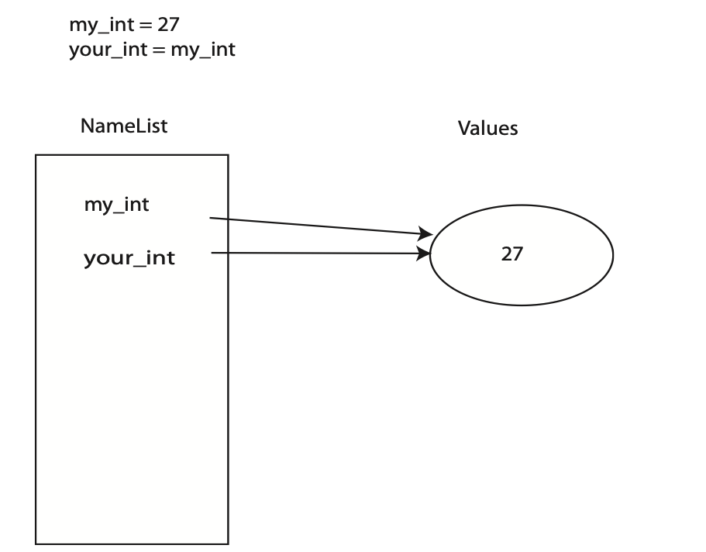

Slide 41
Immutables
Object sharing, two variables associated with the same object, is not a problem since the object cannot be changed
Any changes that occur generate a new object.

Slide 42
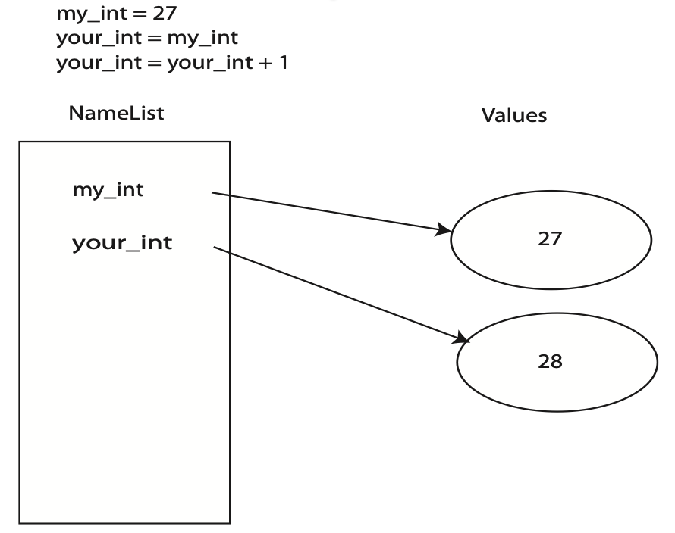

Slide 43
Mutability
If two variables associate with the same object, then both reflect any change to that object

Slide 44
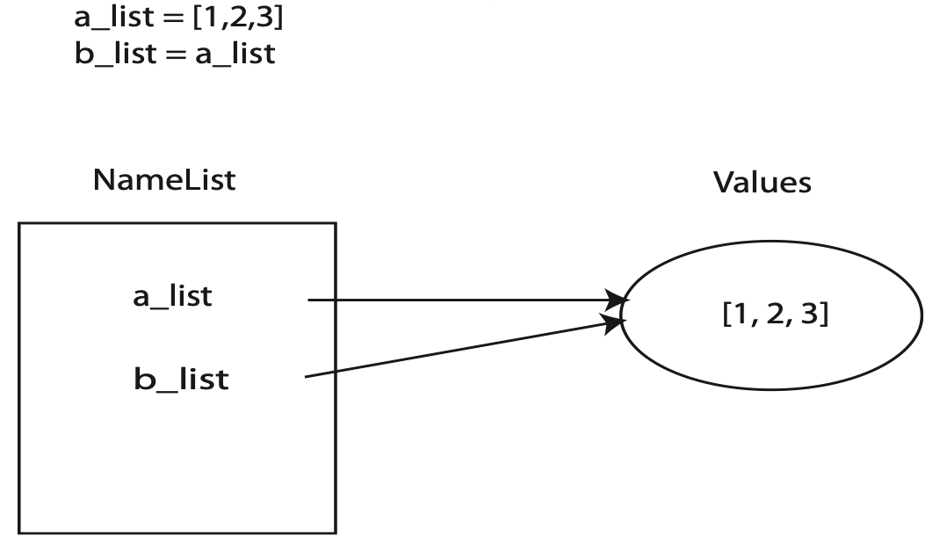

Slide 45
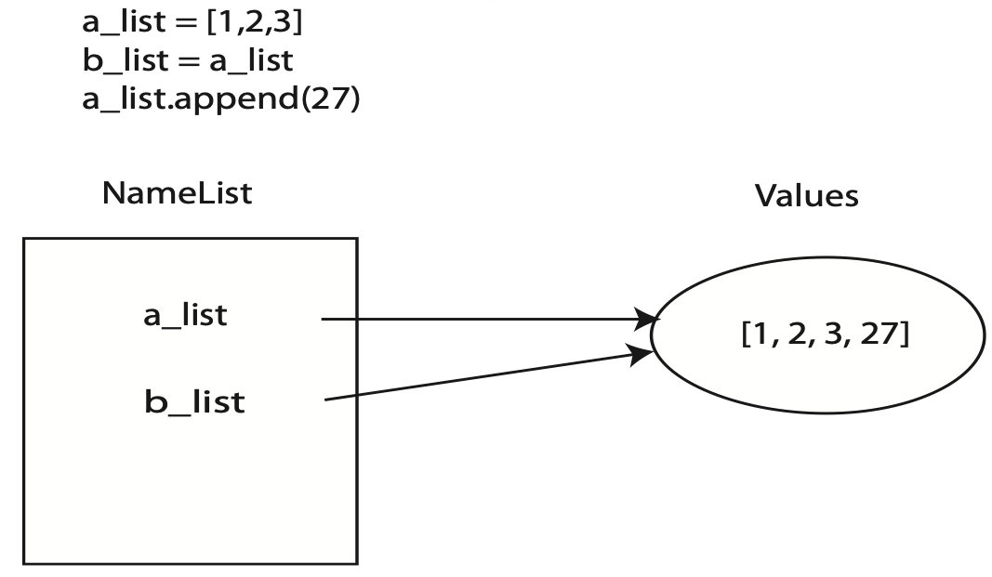

Slide 46
Copying
If we copy, does that solve the problem?
my_list = [1, 2, 3]
newLst = my_list[:]

Slide 47
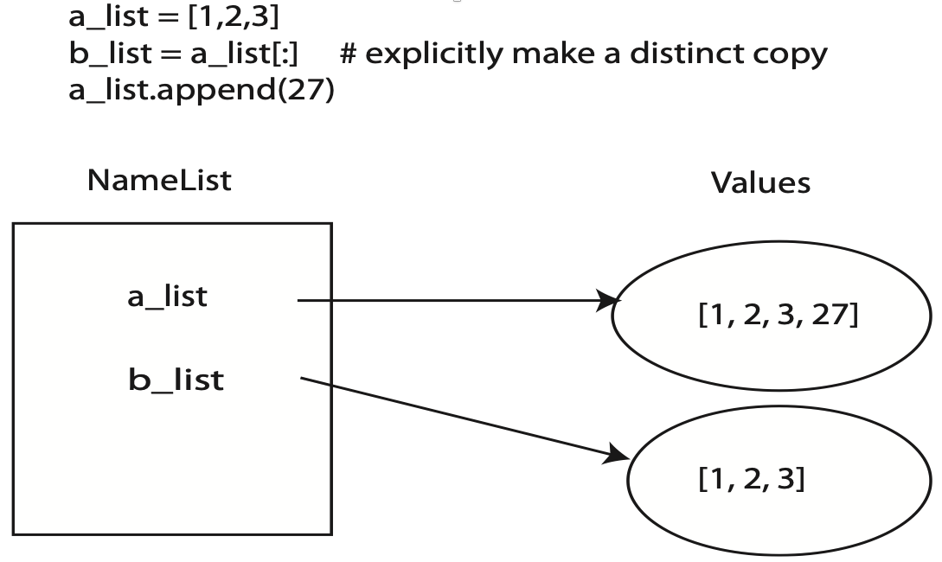

Slide 48
Sort_of/depends - what gets copied?
The big question is, what gets copied?
What actually gets copied is the top level reference. If the list has nested lists or uses other associations, the association gets copied. This is termed a shallow copy.

Slide 53
Shallow vs Deep
Regular copy, the [:] approach, only copies the top level reference/association
If you want a full copy, you can use deepcopy

Slide 55
Tuples

Slide 56
Tuples
A tuple is another sequence data type that is similar to the list. A tuple consists of a number of values separated by commas. Unlike lists, however, tuples are enclosed within parentheses.
The main differences between lists and tuples are: Lists are enclosed in brackets ( [ ] ) and their elements and size can be changed, while tuples are enclosed in parentheses ( ( ) ) and cannot be updated. Tuples can be thought of as read-only lists.

Slide 57
Tuples
tuple = ( 'abcd', 786 , 2.23, 'john', 70.2 )
tinytuple = (123, 'john’)
print tuple # Prints complete list
print tuple[0] # Prints first element of the list
print tuple[1:3] # Prints elements starting from 2nd till 3rd
print tuple[2:] # Prints elements starting from 3rd element
print tinytuple * 2 # Prints list two times
print tuple + tinytuple # Prints concatenated lists
For example:
This produce the following result:
('abcd', 786, 2.23, 'john', 70.2)
abcd
(786, 2.23)
(2.23, 'john', 70.2)
(123, 'john', 123, 'john’)
('abcd', 786, 2.23, 'john', 70.2, 123, 'john')

Slide 58
Tuples
The following code is invalid with tuple, because we attempted to update a tuple, which is not allowed. Similar case is possible with lists:
tuple = ( 'abcd', 786 , 2.23, 'john', 70.2 )
list = [ 'abcd', 786 , 2.23, 'john', 70.2 ]
tuple[2] = 1000 # Invalid syntax with tuple
list[2] = 1000 # Valid syntax with list

Slide 59
Tuples
Tuples are simply immutable lists
They are printed with (,)

Slide 60
The question is, Why?
The real question is, why have an immutable list, a tuple, as a separate type?
An immutable list gives you a data structure with some integrity, some permanent-ness if you will
You know you cannot accidentally change one.

Slide 61
Lists and Tuple
Everything that works with a list works with a tuple except methods that modify the tuple
Thus indexing, slicing, len, print all work as expected
However, none of the mutable methods work: append, extend, del

Slide 62
Commas Make a Tuple
For tuples, you can think of a comma as the operator that makes a tuple, where the ( ) simply acts as a grouping:
myTuple = 1,2 # creates (1,2)
myTuple = (1,) # creates (1)
myTuple = (1) # creates 1 not (1)
myTuple = 1, # creates (1)

Slide 63
Dictionaries

Slide 64
Dictionary
Python's dictionaries are kind of hash table type. They work like associative arrays or hashes found in Perl and consist of key-value pairs. A dictionary key can be almost any Python type, but are usually numbers or strings. Values, on the other hand, can be any arbitrary Python object.
Dictionaries are enclosed by curly braces ({ }) and values can be assigned and accessed using square braces ([]).

Slide 65
Dictionary
dict = {}
dict['one'] = "This is one"
dict[2] = "This is two"
tinydict = {'name': 'john','code':6734, 'dept': 'sales’}
print dict['one'] # Prints value for 'one' key
print dict[2] # Prints value for 2 key
print tinydict # Prints complete dictionary
print tinydict.keys() # Prints all the keys
print tinydict.values() # Prints all the values
For example:
This produce the following result:
This is one
This is two
{'dept': 'sales', 'code': 6734, 'name': 'john’}
['dept', 'code', 'name’]
['sales', 6734, 'john']
Note: Dictionaries have no concept of order among elements. It is incorrect to say that the elements are "out of order"; they are simply unordered.

Slide 66
Arrays

Slide 67
Array
To use arrays in python language, you need to import the standard ‘array’ module. This is because array is not a fundamental data type like strings, integer etc. Here is how you can import ‘array’ module in python :
Once you have imported the ‘array’ module, you can declare an array. Here is how you do it:
In the declaration above, ‘arrayIdentifierName’ is the name of array, ‘typecode’ lets python know the type of array and ‘Initializers’ are the values with which array is initialized.
from array import *
arrayIdentifierName = array(typecode, [Initializers])

Slide 68
Array
Here is a real world example of python array declaration :
In the example above, typecode used is ‘i’. This typecode represents signed integer whose size is 2 bytes.
my_array = array('i',[1,2,3,4])

Slide 69
Array
Typecodes are the codes that are used to define the type of array values or the type of array. Here is the list of available typecodes:
‘b’ -> Represents signed integer of size 1 byte
‘B’ -> Represents unsigned integer of size 1 byte
‘c’ -> Represents character of size 1 byte
‘u’ -> Represents Unicode character of size 2 bytes
‘h’ -> Represents signed integer of size 2 bytes
‘H’ -> Represents unsigned integer of size 2 bytes
‘i’ -> Represents signed integer of size 2 bytes
‘I’ -> Represents unsigned integer of size 2 bytes
‘w’ -> Represents Unicode character of size 4 bytes
‘l’ -> Represents signed integer of size 4 bytes
‘L’ -> Represents unsigned integer of size 4 bytes
‘f’ -> Represents floating point of size 4 bytes
‘d’ -> Represents floating point of size 8 bytes

Slide 70
Basic example using array
Here is a simple example of an array containing 5 integers
from array import *
my_array = array('i', [1,2,3,4,5])
for i in my_array:
print(i)

Slide 71
Access individual elements through indexes
Individual elements can be accessed through indexes. Here is an example :
Note: remember that indexes start from zero.
>>> my_array[1] 2
>>> my_array[2] 3
>>> my_array[0] 1

Slide 72
Append any value to the array using append() method
Here is an example :
>>> my_array.append(6)
>>> my_array

Slide 73
Insert value in an array using insert() method
We can use the insert() method to insert a value at any index of the array. Here is an example :
>>> my_array.insert(0,0)
>>> my_array

Slide 74
Extend python array using extend() method
A python array can be extended with more than one value using extend() method. Here is an example:
>>> my_extnd_array = array('i', [7,8,9,10])
>>> my_array.extend(my_extnd_array)
>>> my_array

Slide 75
Add items from list into array using fromlist() method
Here is an example:
>>> c=[11,12,13]
>>> my_array.fromlist(c)
>>> my_array

Slide 76
Remove any array element using remove() method
Here is an example :
>>> my_array.remove(13)
>>> my_array

Slide 77
Remove last array element using pop() method
Here is an example :
>>> my_array.pop()
12
>>> my_array

Slide 78
Fetch any element through its index using index() method
Here is an example :
>>> my_array.index(5)
5

Slide 79
Reverse a python array using reverse() method
Here is an example :
>>> my_array.reverse()
>>> my_array

Slide 80
Check for number of occurrences of an element using count() method
Here is an example :
>>> my_array.count(11)

Slide 81
Convert array to string using tostring() method
Here is an example :
>>> my_char_array = array('c', ['g','e','e','k’])
>>> my_char_array
array('c', 'geek’)
>>> my_char_array.tostring()
'geek'

Slide 82
Convert array to a python list with same elements using tolist() method
Here is an example :
>>> c = my_array.tolist()
>>> c
[11, 10, 9, 8, 7, 6, 5, 4, 3, 2, 1, 0]

Slide 83
Append a string to char array using fromstring() method
Here is an example :
>>> my_char_array.fromstring("stuff")
>>> my_char_array
array('c', 'geekstuff')

Slide 84
Next Session!
File & I/O
Reading / Writing to files

